Slide 1

SMART IRRIGATION
RITHIKA M 210701214
SELVANANDHINI S 210701237

Slide 2
1
AGENDA:
Problem statement
Objectives
Problem in existing system
Proposed system
Components required
System architecture
Benefits
Conclusion

Slide 3
2
PROBLEM STATEMENT
Traditional irrigation inefficiencies lead to crop yield loss.
Smart irrigation integrates sensors, data analytics, and automation.
Real-time optimization conserves resources and maximizes yields.
Monitoring soil moisture, weather, and crop needs enables precise scheduling.

Slide 4
3
OBJECTIVES
Maximize water efficiency through precise scheduling.
Optimize crop yields with tailored water supply.
Minimize wastage and environmental impact with sensor integration.
Reduce operational costs through automation.
Enhance resilience to climate variability with data-driven strategies.

Slide 5
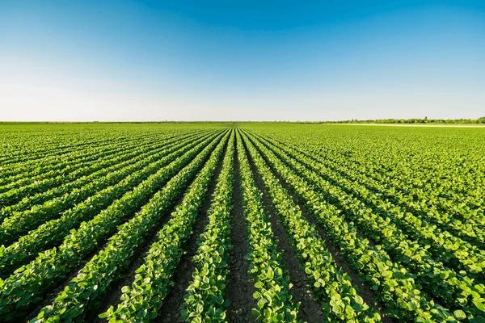
10
PROBLEMS WITH SIMPLE EXISTING SYSTEM
Different patches in land requires different nutrients so no single sensor can be used
To manage large areas of crop we must accomodate and manage too many sensors
Elivation in terrains may cause a problem and also using many wireless increase the cost and energy

Slide 6
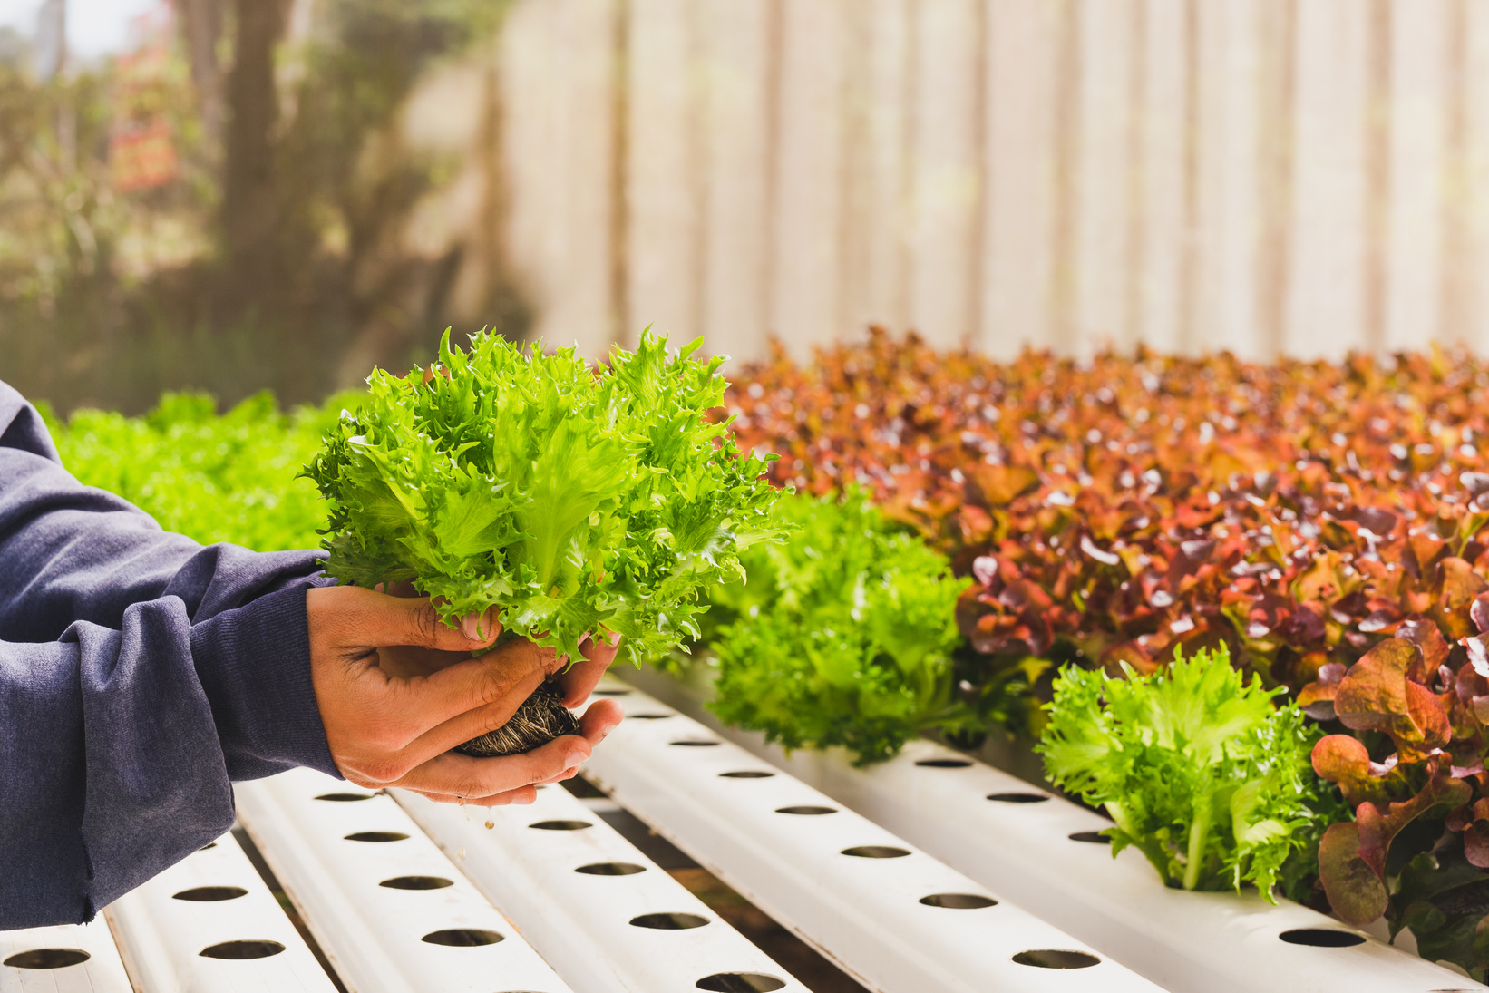
7
PROPOSED SYSTEM
The proposed system combines an ESP32 microcontroller with a soil moisture sensor to detect soil moisture effectively. Sensor data is transmitted wirelessly to the Blynk app through Wi-Fi, enabling seamless real-time monitoring of the plant moisture level on users' smartphones

Slide 7
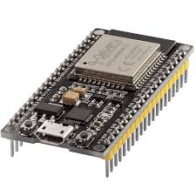
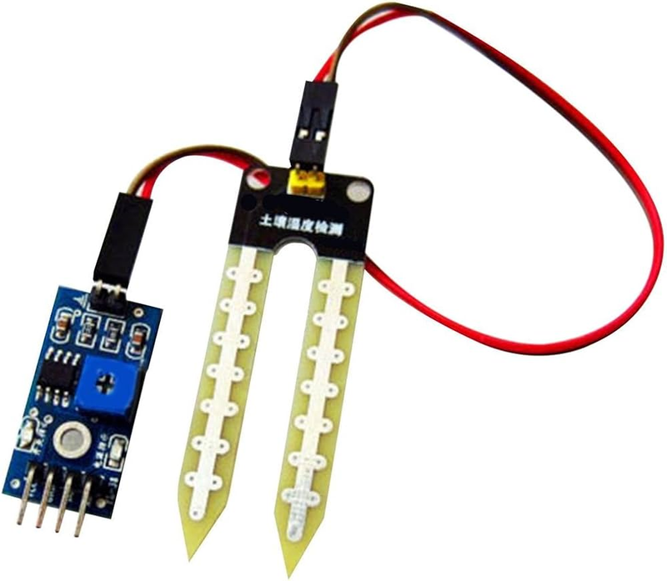
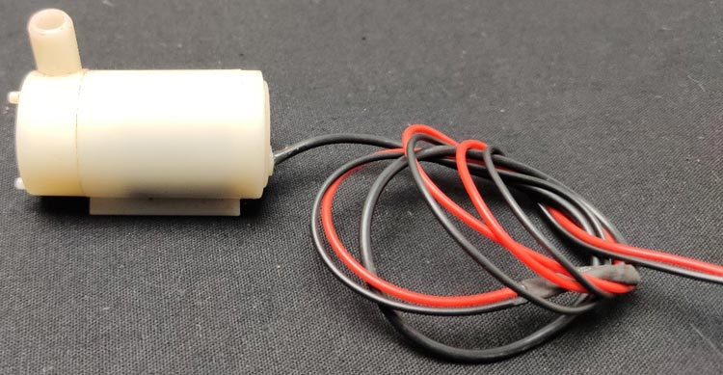
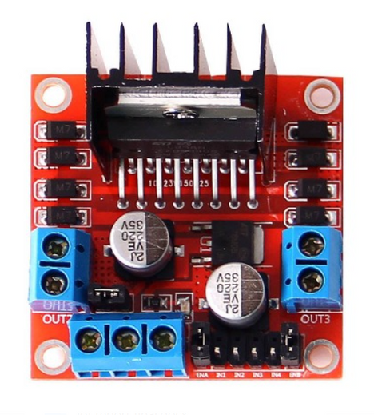
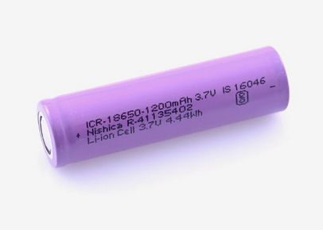
4
COMPONENTS REQUIRED
SOIL MOISTURE SENSOR
PUMP
MICRO CONTROLLER
L298D motor driver
Lithium ion battery

Slide 8
5
FUNCTIONAL DESCRIPTION
Sensor Deployment: Sensors collect data on soil moisture, weather, etc.
Data Collection and Transmission: Data is sent to a central system.
Data Analysis: Real-time analysis determines irrigation needs.
Irrigation Control: Automated valves adjust water flow accordingly.
User Interface: Farmers monitor and control the system remotely.

Slide 9
6
SENSORS
Soil Moisture Sensor
A soil moisture sensors is a device designed to measure the level of moisture present in the soil. It typically consists of a probe that is inserted into the soil, where it detects the moisture content

Slide 10
8
ACTUATORS
Pump
pumps serve as actuators by regulating the flow of water from the water source (such as a well or reservoir) to the irrigation network. They adjust water flow rates and pressure levels based on data from
the cloud.

Slide 11
7
L298D MOTOR DRIVER
L298D motor driver
It is a motor driver,where Motor driver is used to control motion of a motor and its direction by feeding current accordingly.

Slide 12
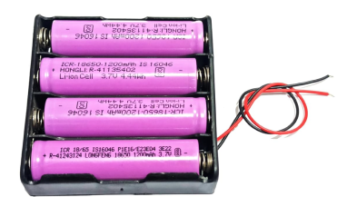
7
LITHIUM ION BATTERY
Lithium ion battery
A lithium-ion battery is a type of rechargeable battery that is charged and discharged by lithium ions moving between the negative (anode) and positive (cathode) electrodes.

Slide 13
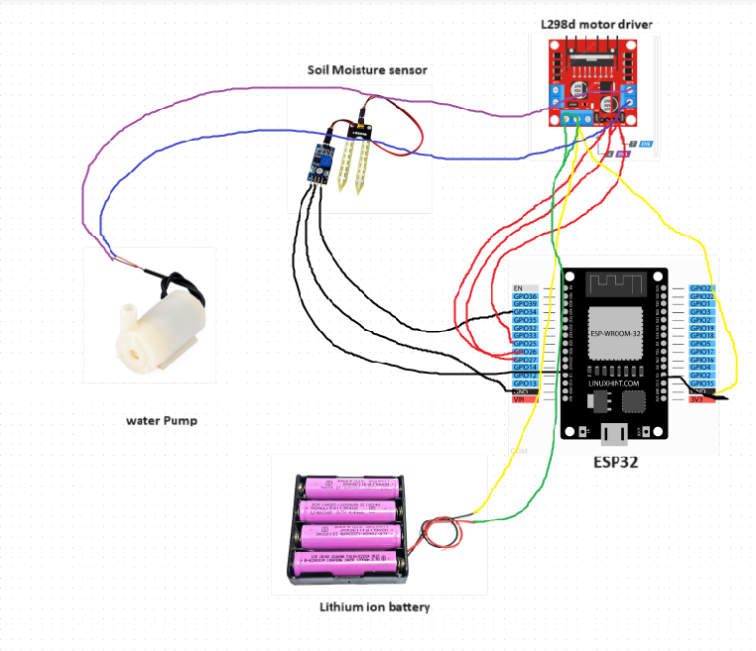
9
SYSTEM ARCHITECTURE

Slide 14
11
﻿RESULT
The implementation of smart irrigation systems, leads to sustainable water management practices, reduced operational costs, and increased crop yields, demonstrating the substantial benefits of smart irrigation technology.

Slide 15



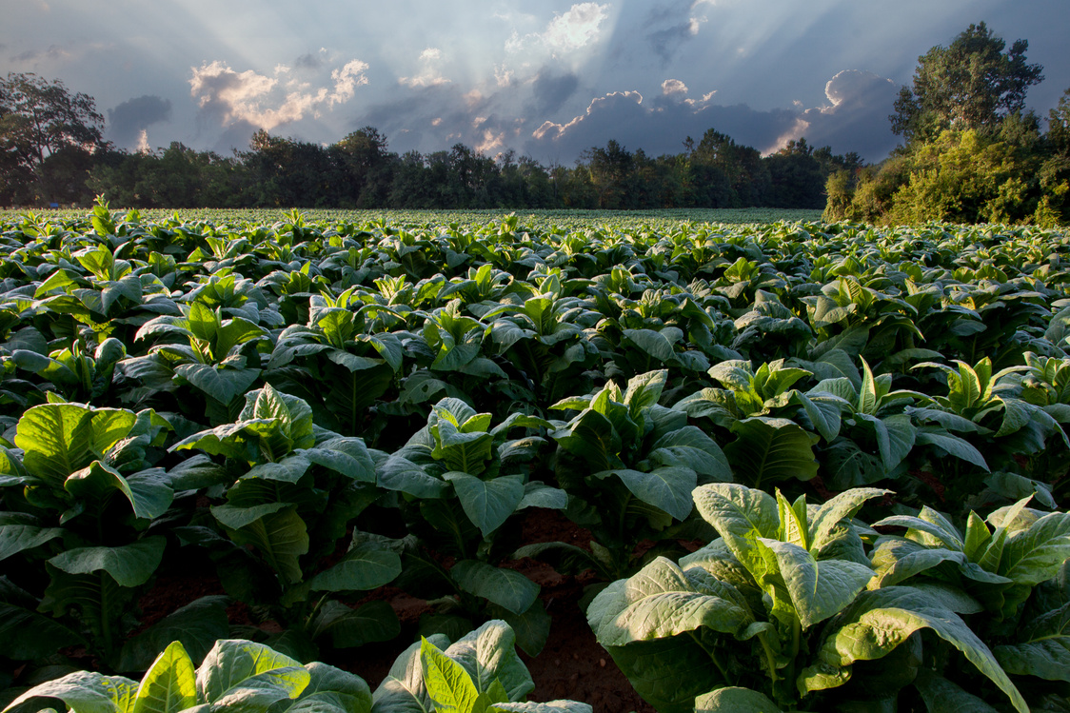
12
CONCLUSION AND FUTURE ENHANCEMENT
In conclusion,Real-time monitoring and irrigating the plants at correct interval with adequate amount of water improves the plant health and increases the quantity of the supply. By using advancements in AI and machine learning algorithm we can make predictions and the latency can be reduced for faster performance.

Slide 16
15
Thank You

